Slide 1
2023 Student Success Summit
Legislative Update
April 25, 2023
Remmele J. Young, J.D., Vice Chancellor

Slide 2
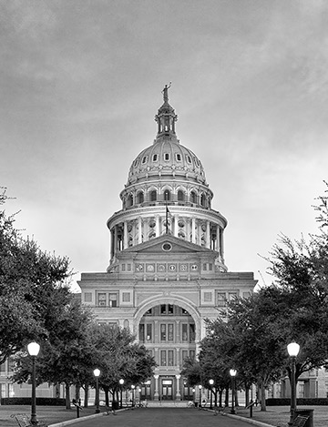
Discussion Topic
88th TEXAS LEGISLATIVE SESSION
& RELATED CONSIDERATIONS
2

Slide 3
HCC is tracking 783 bills.
3

Slide 4
COMMUNITY COLLEGES APPROPRIATIONS
2024-2025 BIENNIUM
HB 1
2024-2025
Biennium
SB 1
2024-2025
Biennium
$1,881,207,603
General Appropriations
$1,881,207,603
General Appropriations
4

Slide 5
HCC REGIONAL RESPONSPE
EMERGENCY TRAINING CENTER
2024-2025 BIENNIUM
HB 1
2024-2025
Biennium
SB 1
2024-2025
Biennium
$2,375,000
General Appropriations
$2,375,000
General Appropriations
5

Slide 6
HCC APPROPRIATIONS
HB 1 2024-2025 Biennium
$1,360,812
$20,786,230
$103,771,018
SB 1 2024-2025 Biennium
$1,360,812
$20,786,230
$103,771,018
Core Operations
Student Success
Contact Hours
$125,918,060
Total
$125,918,060
6

Slide 7
HCC NON-FORMULA SUPPORT
HB 1 2024-2025 Biennium
$2,375,000
SB 1 2024-2025 Biennium
$2,375,000
Regional Response Emergency Training Center
$2,375,000
Total
$2,375,000
7

Slide 8
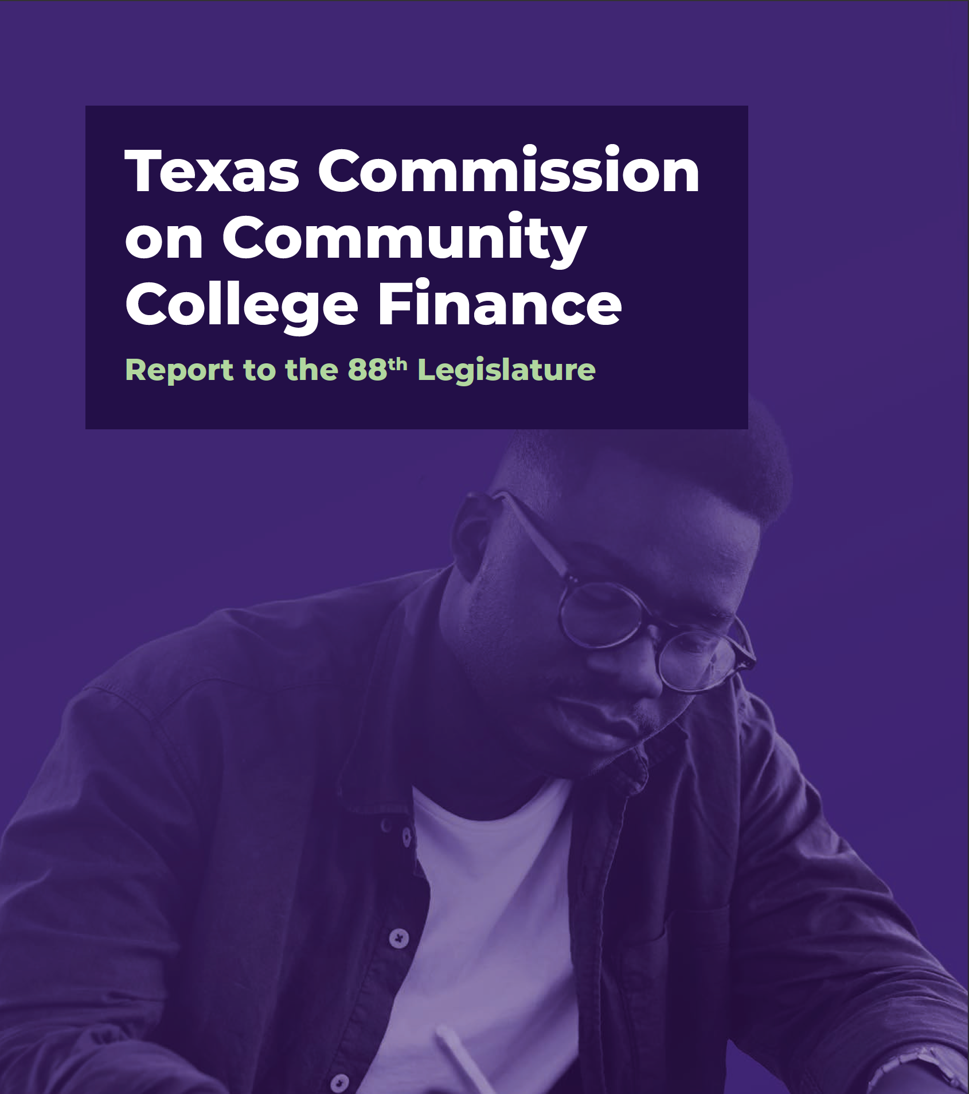

Slide 9
COMMISSION’S FINAL RECOMMENDATIONS*
1
2
3
State Funding
For Outcomes
Affordability
For Students
Investments In
College Capacity
Develop modern finance model that distributes state funding based on measurable outcomes (e.g., credential of value, transfers and completions).
Ensure community colleges can access foundational levels of funding through state-funded guaranteed yield.
Increase funding for Texas Educational Opportunity Grants (TEOG) and link state performance measures between TEOG eligible students and TEXAS Grants at universities.
Provide financial aid for dual credit for economically disadvantaged students.
Expand partnerships among colleges and private employers for paid work-based learning opportunities.
Provide one-time seed grants for programs in high-demand fields that meet regional and state workforce needs.
Support and facilitate shared services and stronger inter-institutional partnerships.
Update state policies to help colleges provide high-quality non-credit credential programs that are convertible and stackable with credit-bearing programs.
$
* Relevant bills are HB 8 and SB 2539 (88R legislative session).
9

Slide 10
ARTICLE III RIDER SPECIAL PROVISION
GENERAL REVENUE 2024
$214,000,000
$16,500,000
$62,500,000 $7,000,000 $25,000,000
GENERAL REVENUE 2025
$214,000,000
$16,500,000
$62,500,000 $7,000,000 $25,000,000
Formula
Workforce
TEOG
TEOG (State & Technical Colleges)
Economically Disadvantaged
Students Dual Credit
$325,000,000
$325,000,000
Total
2024-2025 Biennium
$650,000,000
10

Slide 11
KEY BILL TRACKING
HB 1 (Bonnen) General Appropriations Bill
Identifies state appropriations for all state agencies and other entities, including higher education institutions, for the 2024-2025 biennium.
SB 1 (Huffman) General Appropriations Bill
Identifies state appropriations for all state agencies and other entities, including higher education institutions, for the 2024-2025 biennium.
Status: Passed House and Senate; conferees appointed.
April 21, 2023.*
Status: Voted favorably from Senate. April 12, 2023.*
* Key bill tracking status is current as of April 22, 2023.
11

Slide 12
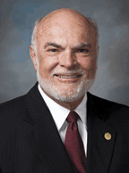
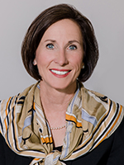
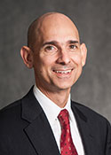
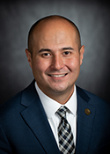
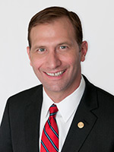
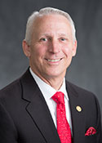
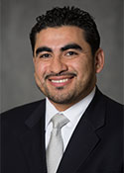
BUDGET CONFEREES
88th LEGISLATIVE SESSION
Senate
House
Sen. Joan Huffman* Chair
Sen. Robert Nichols
Sen. Lois Kolkhorst
Rep. Greg Bonnen, Chair
Rep. Mary Gonzalez
Rep. Jacey Jetton
Sen. Brandon Creighton
Sen. Charles Schwertner
Rep. Gary VanDeaver
Rep. Armando* Walle
* HCC delegation member.
12
Notes:
Ricardo, please adjust slide for good visual – spacing, size of pics, etc.

Slide 13
KEY BILL TRACKING
HB 8 (VanDeaver et al.)
Relating to the administration, coordination,
and support of public higher education,
Including the public junior college finance
Program and an Advanced Career Education
(ACE) scholarship program for students in dual
Credit courses.
SB 2539 (Creighton et al.)
Relating to the administration, coordination,
and support of public higher education,
Including the public junior college finance
Program and an Advanced Career Education
(ACE) scholarship program for students in dual
Credit courses.
Status: Passed House; received in Senate.
April 12, 2023.*
Status: Action pending in Senate Subcommittee
on Higher Education. March 23, 2023.*
* Key bill tracking status is current as of April 22, 2023.
13

Slide 14
KEY BILL TRACKING
HB 4104 (Johnson, Ann)
Relating to a nursing dual credit pilot
program. Among other things, establishes
program through which HISD students may
graduate from high school with a certificate in
licensed vocational nursing from HCC and UT
Health.
SB 17 (by Creighton)
Relating to public higher education reform. Among other things, prohibits universities from establishing or maintaining Diversity Equity & Inclusion (DEI) offices, officers, employees, or contractors that perform the duties of a DEI office.
Status: Introduced and referred to committee on House
Higher Education.
March 21, 2023.*
Status: Passed Senate; received in the House. April 20, 2021.*
* Key bill tracking status is current as of April 22, 2023.
14

Slide 15
KEY BILL TRACKING
HB 5330 (Reynolds)
Relating to service are of Houston Community
College System District. Assigns to HCC the part of FBISD that is not located in the incorporated areas of the Wharton County Junior College District and that is adjacent to the HCC System District.
SB 2581 (by Miles)
Relating to service are of Houston Community
College System District. Assigns to HCC the part of FBISD that is not located in the incorporated areas of the Wharton County Junior College District and that is adjacent to the HCC System District.
Status: Committee action pending House
Higher Education.
April 24, 2023.*
Status: Introduced and referred to Senate
on Higher Education. March 30, 2021.*
* Key bill tracking status is current as of April 22, 2023.
15

Slide 16
HCC LEGISLATIVE TIMELINE
Seek HCC Board Approval/Adoption of Leg. Initiatives/Agenda
Engage in Session Committee Hearings and Related Policy Work
Post Session Deadline
for Governor to Sign
or Veto Bills
Devise HCC
Leg. Agenda with
Admin, ERC and Board
General Election
(Nov. 8)
Mar
2020
Jan
2023
Feb
2023
Mar
2023
Apr
2023
May
2023
Jun
2023
Jan
2020
Feb
2020
Apr
2020
May
2020
Jun
200
Aug
2022
Sep
2022
Oct
2022
Nov
2022
Dec
2022
Bill Filing Deadline
(Mar. 10)
Engage in Interim Session Hearings
88th Leg. Session
Convenes (Jan. 10)
Adjournment
sine die (May 29)
Bill Pre-filing
(Nov. 14)
Inform Legislators et al. about HCC Policy Priorities
16
Notes:
Engage in Interim Session Hearings

Slide 17
Questions/ Discussion

Slide 18
Thank you
18

