Slide 1
Program Vitality
Achieving the Dream – Site Visit
April 14, 2022

Slide 2
Agenda
Tracking Program Vitality
Table Top Discussion: What do good vitality metrics look like?
Table Top Discussion: What is the Program Vitality Report for?
Table Top Discussion: Academic Program Vitality

Slide 3
Tracking Program Vitality

Slide 4
Program Vitality Overview
Until 2020, program vitality report followed manual procedure dating back to 1999.
Program Vitality data were primarily used as part of program review.
The Program Vitality Task Force was convened to create a better, more automated tool.

Slide 5
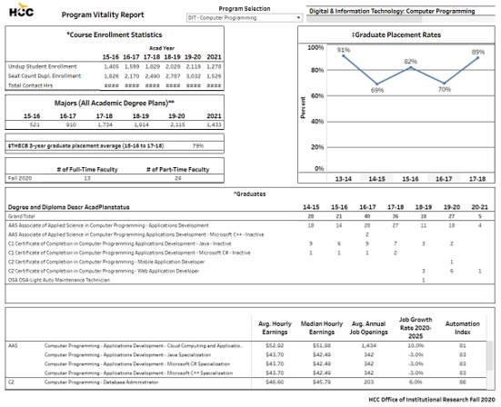
2020 Program Vitality Report

Slide 6
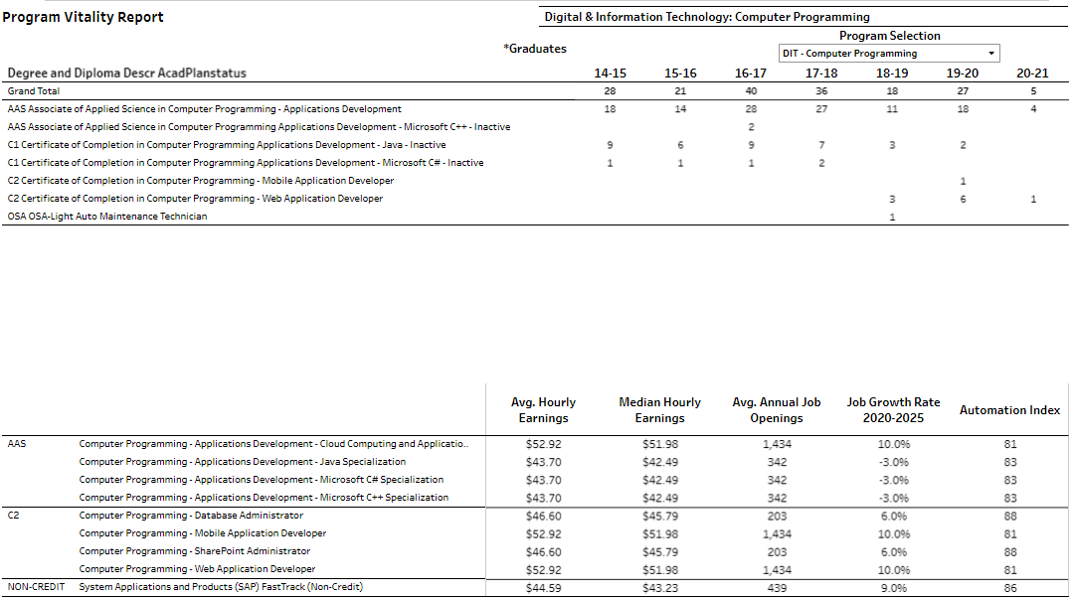
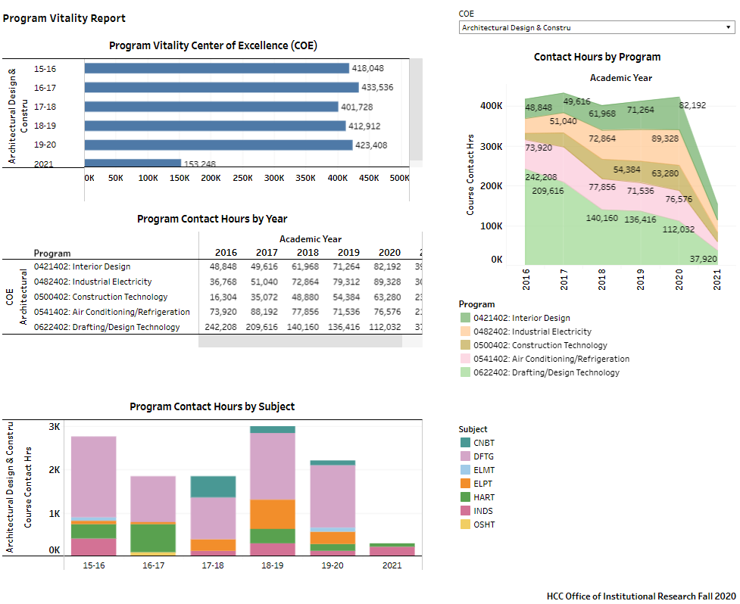
2020 Program Vitality Report

Slide 7
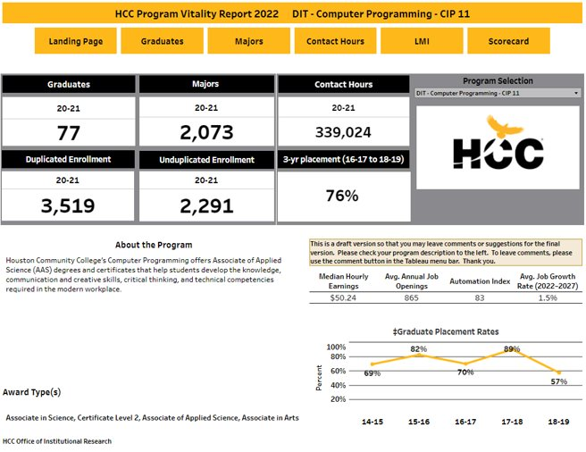
2022 Program Vitality Report

Slide 8
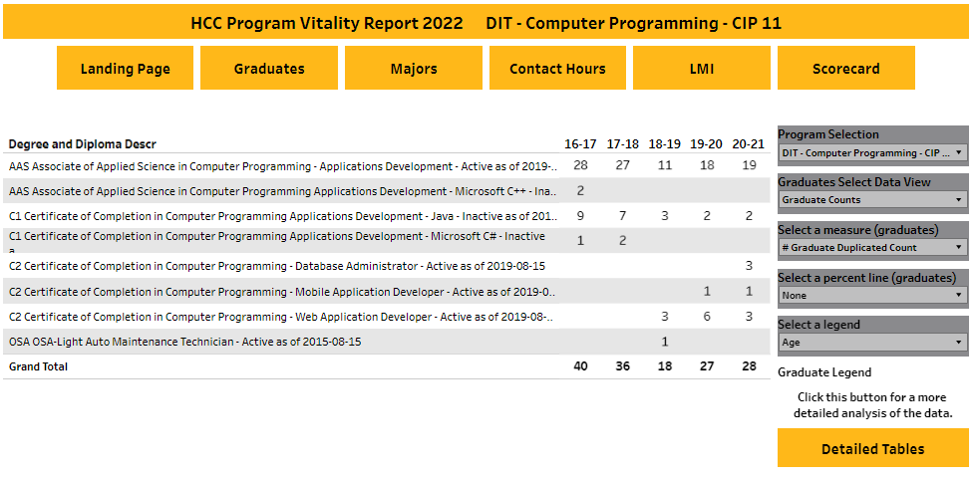
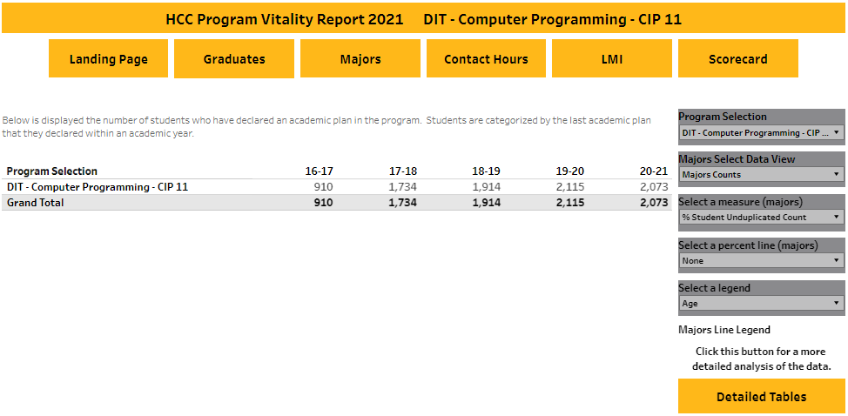
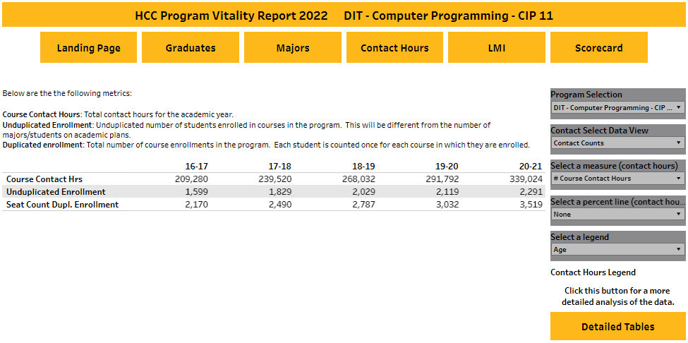
2022 Program Vitality Report

Slide 9
Table Top Discussion: What do good vitality metrics look like?

Slide 10
Guiding Questions
What measures are most important for understanding the health of a program?
Do the current metrics capture the key elements of a program?
What additional metrics should be prioritized? How would they be used?
What other sources of evidence should a program triangulate in?

Slide 11
Table Top Discussion: What is the Program Vitality Report for?

Slide 12
Guiding Questions
How has your program used the vitality report in prior years?
What types of decisions can/should be made using the vitality report?
Does it have the relevant information to make the decisions you need to make?
What role should the vitality report play for other evaluation activities related to things such as the Personalized Learning Pathways initiative, Program Review, etc.?

Slide 13
Table Top Discussion: Academic Program Vitality

Slide 14
Guiding Questions
What measures are most important for understanding the health of an academic program?
What additional metrics should be prioritized? How would they be used?
Are there metrics in use for workforce programs that are not useful for academic programs?
How might a vitality process integrate with the four-year program review?

Slide 15
Report Out
What are 1 to 2 key points from your discussion?

Slide 16
Thank You!

